Slide 1
Badgers Meet the teachers
Monday 11th September

Slide 2
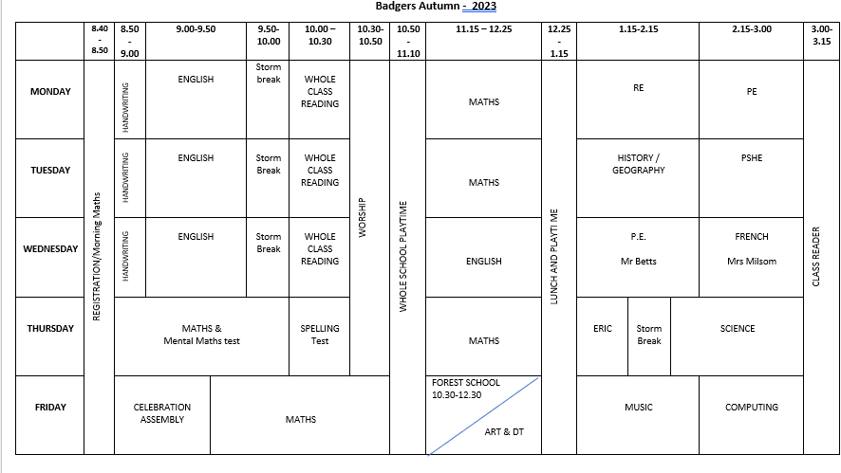

Slide 3
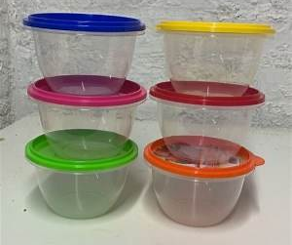
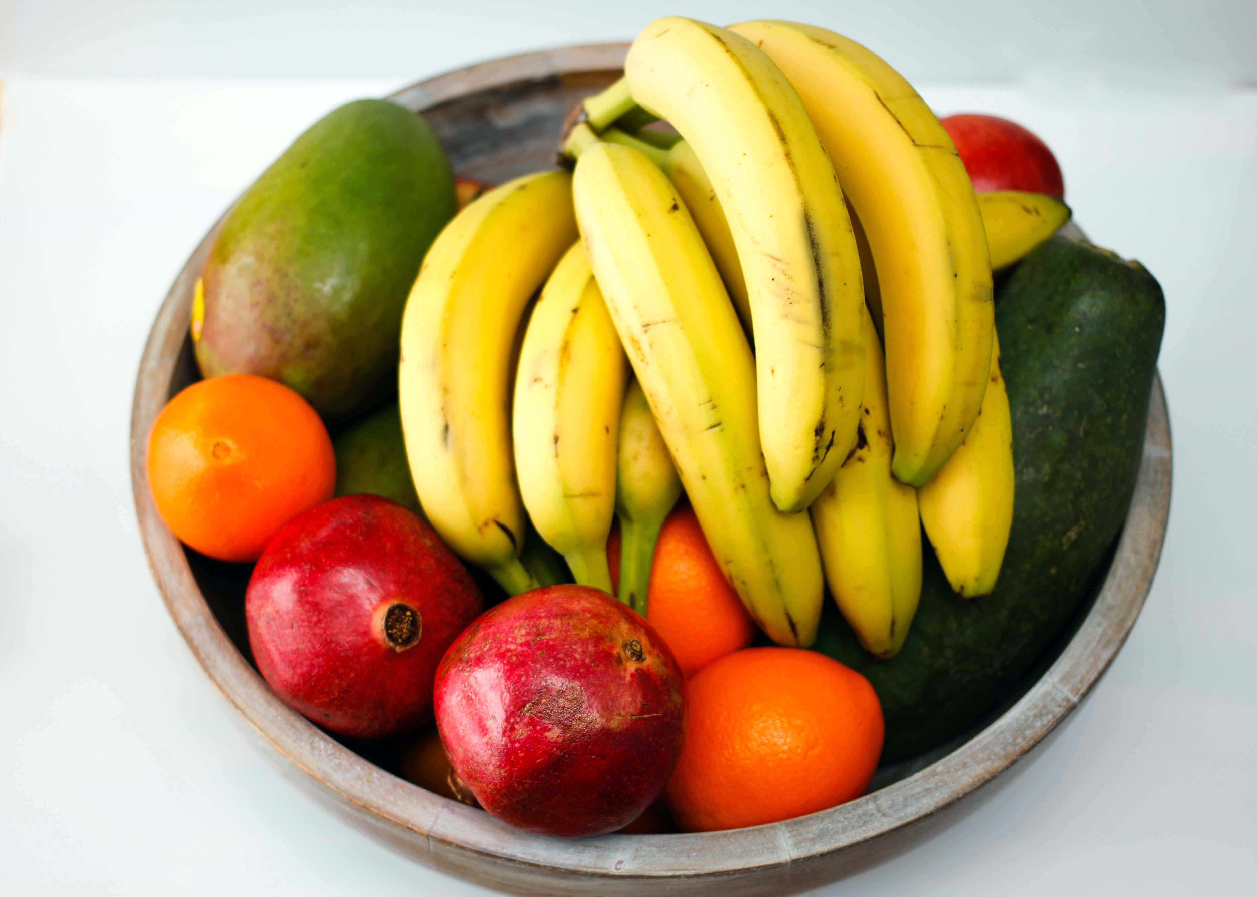
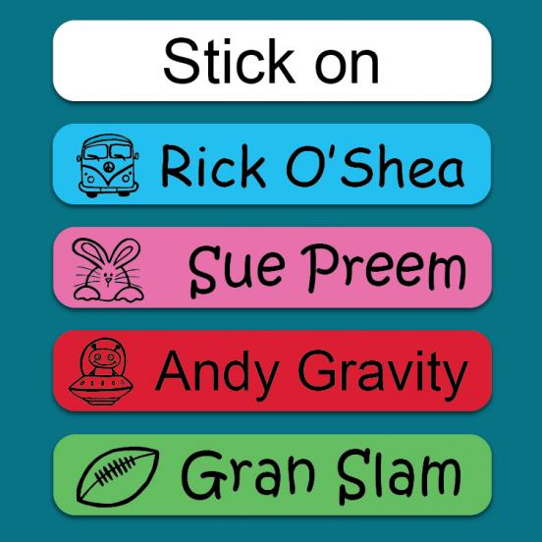
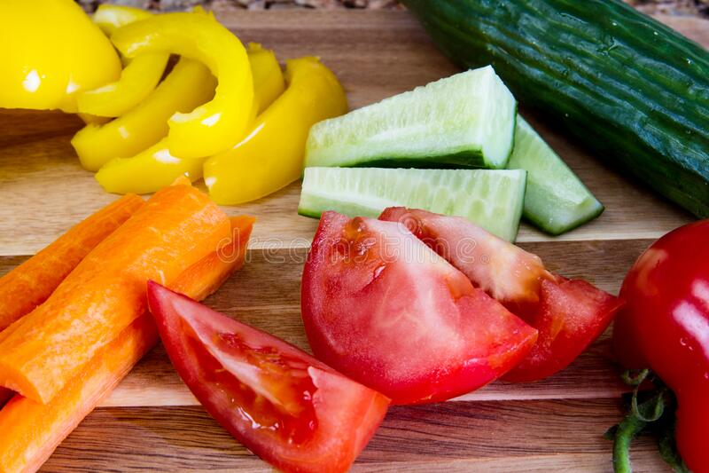
Snack Time

Slide 4
What to bring

Slide 5
Homework

Slide 6
Communication

Slide 7
Any questions?

