Slide 1
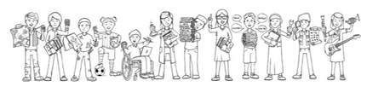

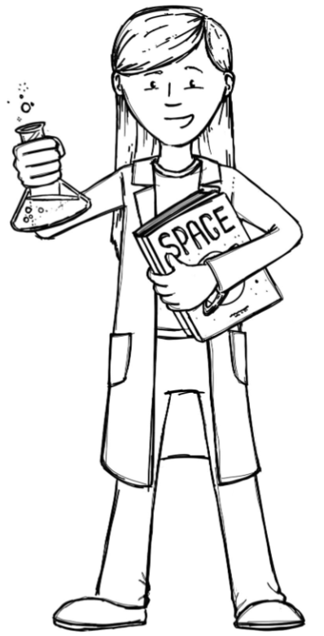
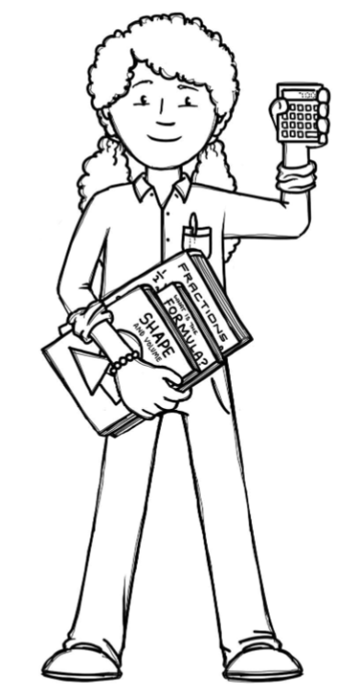
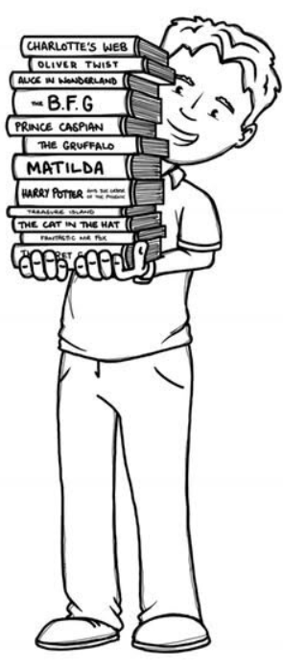
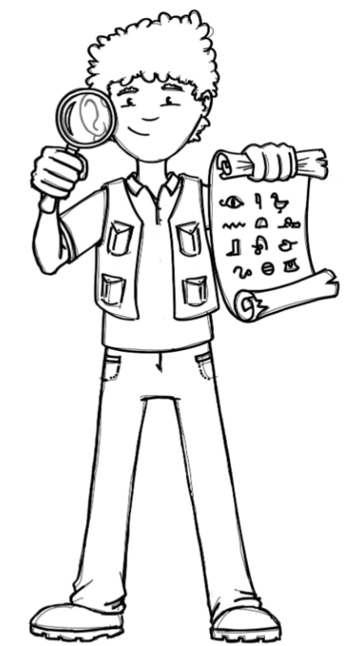
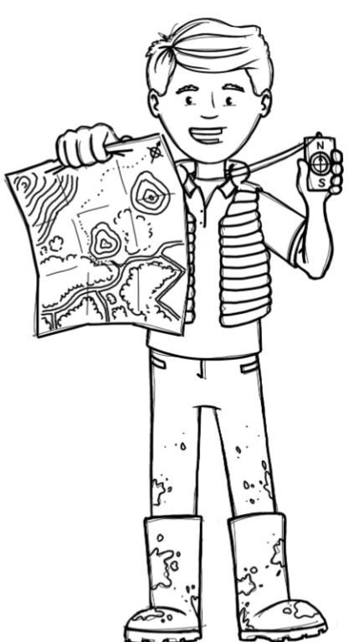
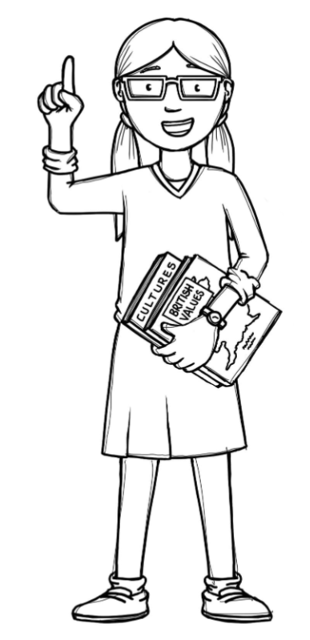
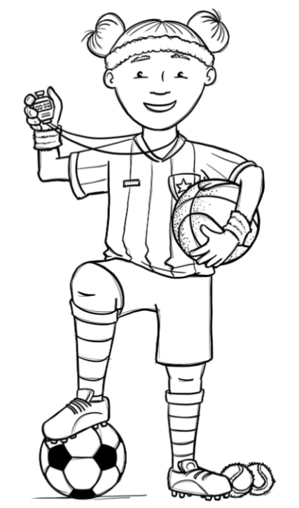
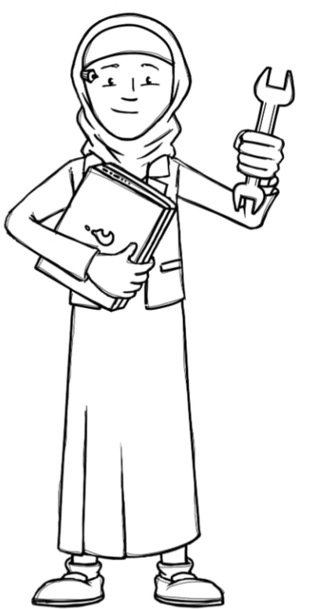
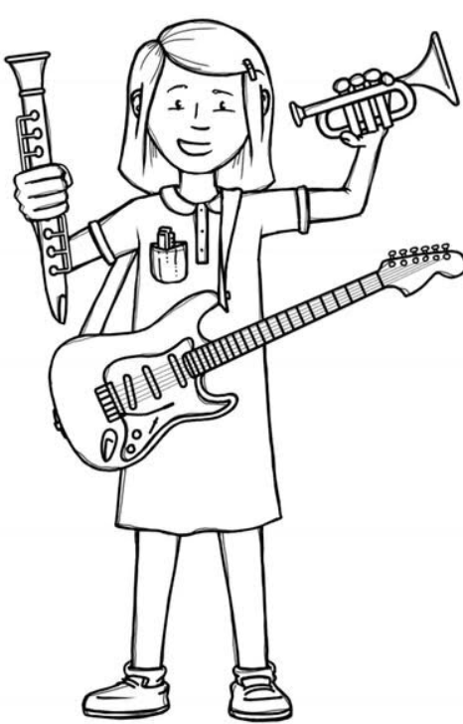
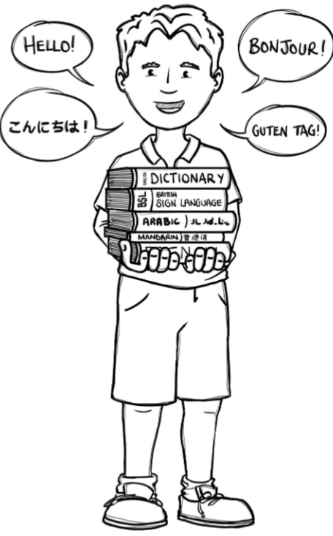
Hedgehogs Class Curriculum Overview—Autumn 2
Enquiry 3: How can I join two things together?
Being Mathematicians
Being Scientists
We will be using our knowledge of mathematics to show what we know about numbers, counting and understanding amounts.
We will be sharing stories about hats. Finding out about hats for different purposes and talking about the vocabulary we encounter.
We will be working on starting to write and explore mark making in various forms.
Being Authors and Readers
We will be finding out about how our school changes from Autumn to Winter.
As part of our enquiry we will be
finding out about different materials and their properties.
Being Historians and Geographers
We will be looking at where
we live, talking about how our
seasons change in the United
Kingdom compared to other parts of
the world.
Being Philosophers
Being Athletes
Taking part in class PE sessions with our class teacher and visiting sports coaches.
We will be talking about
why Christians perform
Nativity plays at Christmas and performing our own!
Being computer scientists
Being Artists and Engineers
Being a Musician
Exploring logging on in the computer room and using Numbots.
Being Linguists
We will be constructing a hat to
wear to a party using a variety of different joining techniques.
Exploring a variety of musical instruments.
Joining in with singing and rhyming.

